Slide 1
FoodReal
Two Seniors
Week 9
Kimlong Hor, Yunseo Claire Han [leader]

Slide 2
Progress
Implemented push notifications
Implemented User sign up and profile creation in the database

Slide 3
DEMO

Slide 4
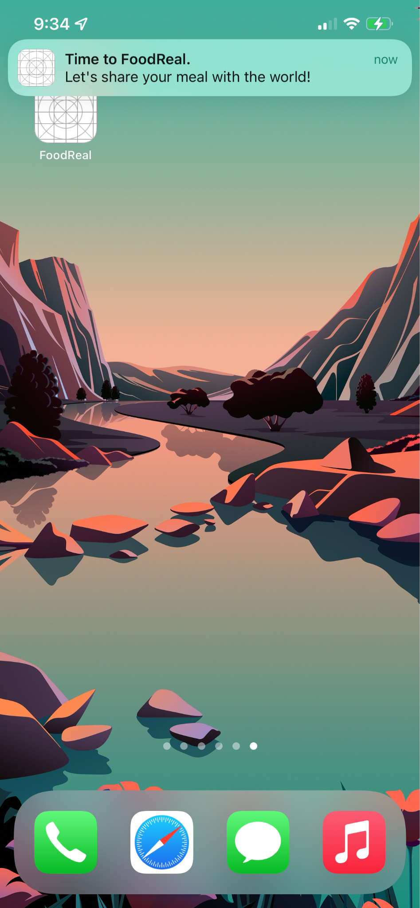
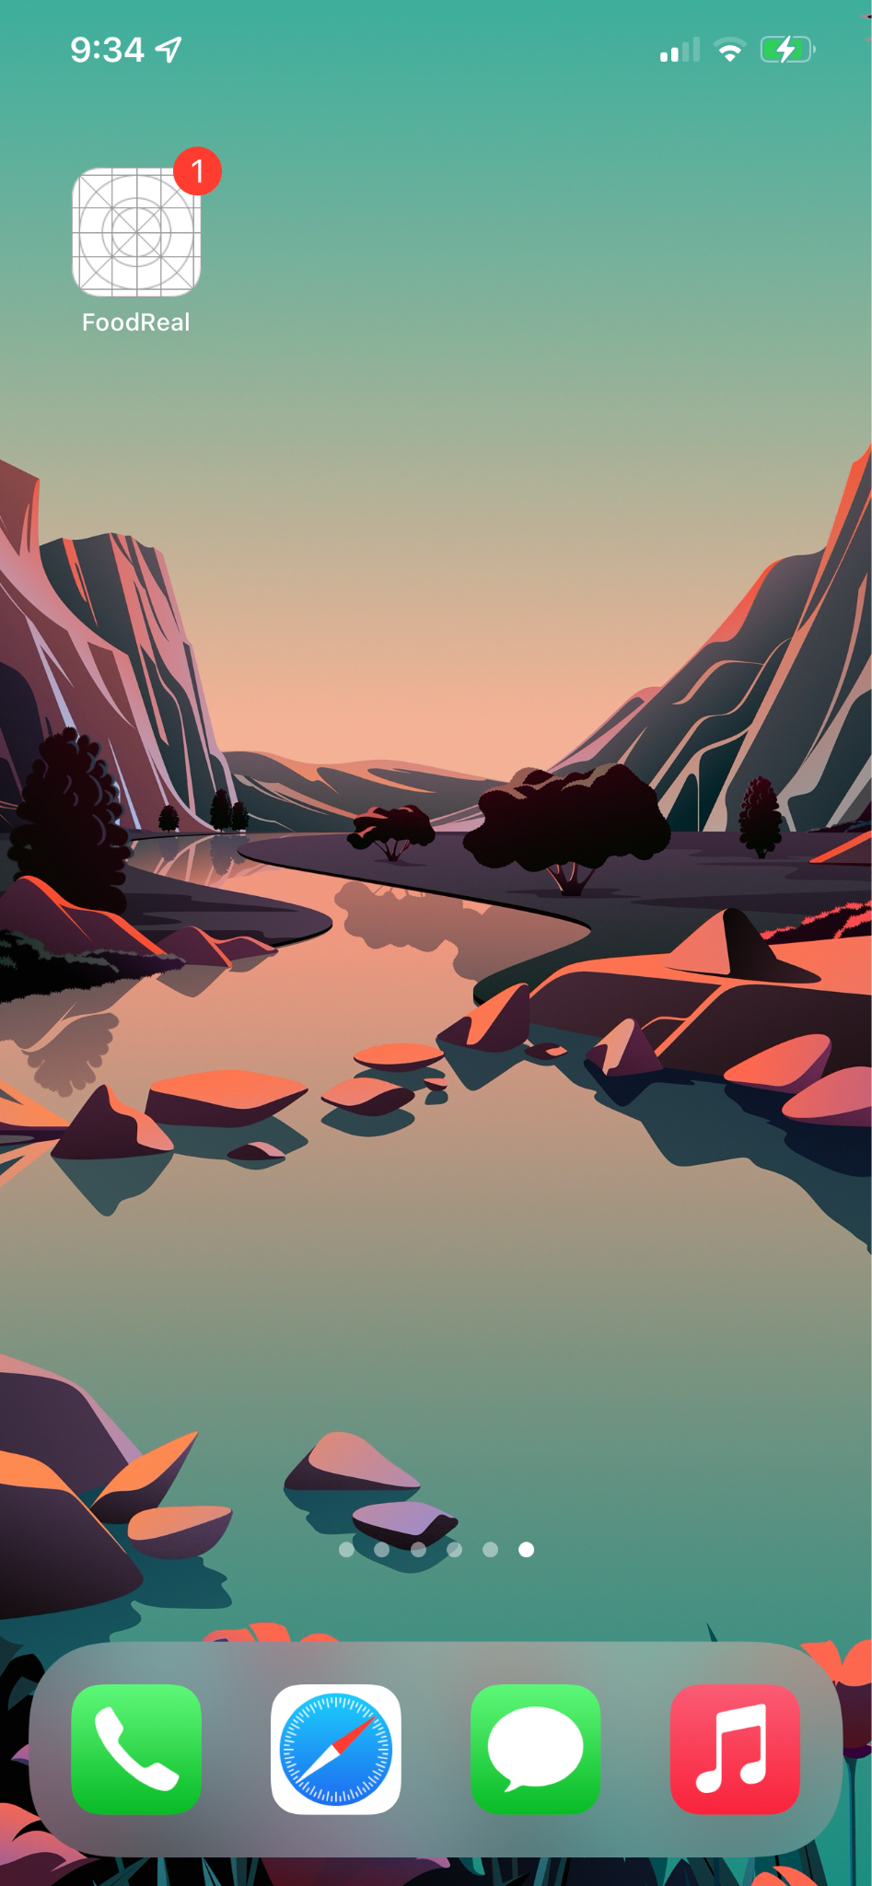
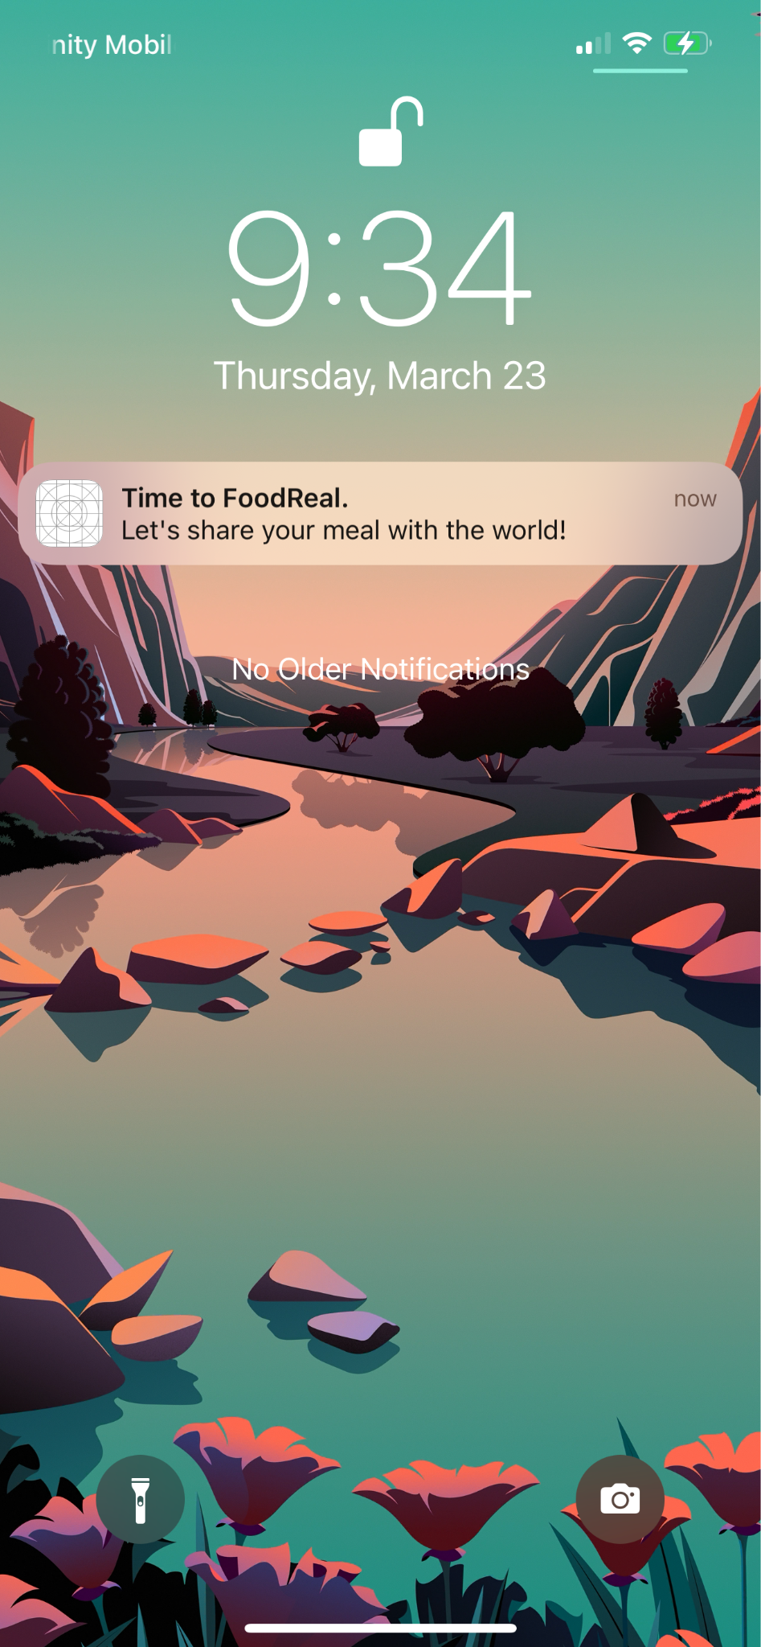
Notification

Slide 5
Milestones
By the end of | These milestones will be reached
Week 2 | Plan UI structure and components Set up Firestore project
Week 4 | Plan database collection and document structure Write Create and Read operation for posting wall Base UI implementation of posting wall
Week 6 | Posting wall with functionality Set up firebase authentication
Week 8 | Implement picture taking functionality Write rest of CRUD operation
Week 10 | User onboarding screens Implement notification
Week 12 | Polish up the app Test the app
🙂
🙂
🙂
😐

Slide 6
Testing Plan Highlights
User Onboarding
Camera
Posting
Notifications

Slide 7
Testing Plan: User Onboarding
Users will be taken through a series of screens to instruct them on signing up for FoodReal.
Name
Birthday
Email
Password
Testing:
User testing
Manual testing
Database unit testing

Slide 8
Testing Plan: Camera
User is able to capture images with front and back cameras with one click
User is able to switch between the front and back cameras
Testing:
User testing
Manual testing

Slide 9
Testing Plan: Posting
User will be able to add a description to their pictures and press “send” button to post in on the public wall
Posts will be saved into Cloud Firestore in “Posts” collection
Testing:
User testing
Manual testing
Database unit testing

Slide 10
Testing Plan: Notifications
User will be able to configure daily notification times to remind them of their meals
Set 3 times for 3 notifications per day:
Breakfast
Lunch
Dinner
Notification settings will be stored in Cloud Firestore
Testing:
User testing
Manual testing
Database unit testing

Slide 11
Follow-up of your previous responses
None

Slide 12
User Friendliness
Sign up guide
We believe our onboarding guides are simple and pretty user friendly
Filtering posts
Giving the users the ability to filter posts by likes instead of exclusively time would be nice
Saving posts
Feature to help users keep track of posts they like
Some users may have to scroll for a long time if they want to look back on a post
Recalling password
Would definitely be a necessary features for users to recover their accounts
Need to set up some sort of email authentication
Automatic Log out
Not a priority for mobile app, would hinder user friendliness if they user had to re-log in too often

Slide 13
Partner Feedback (ThriveToday)
A feature that helps users plan their eating time and hold up their eating schedule would be beneficial to the app
Help your users choose when to be notified
Maybe not a timer, because it’s easy to dismiss
Users check in on other users asking “have you eaten yet?”
Response:
The interactive reminder features definitely fits the objective of the app
Also increases user interactivity and retention
It would also give more incentive to users to post as well as stick to their eating schedule
Definitely something to consider adding if time allows

